Slide 1


Slide 3
INTRODUCTION
The weather dataset encompasses a wide range of attributes including temperature, humidity, pressure, wind speed, and direction across various cities. Through Excel and SQL analysis, we aim to unveil weather trends, seasonal shifts, and attribute correlations. A Power BI dashboard will provide insightful visualizations for weather monitoring and historical analysis.

Slide 4
Objective
Insights & Findings
Report & Presentation
Analyze weather data to identify trends, seasonal variations, and correlations, and create a Power BI dashboard for weather monitoring and analysis.
Insights and findings gleaned from weather data analysis include seasonal variations, correlations between weather attributes, and trends aiding predictive modeling for informed decision-making.
The report and presentation will showcase comprehensive weather analysis, seasonal trends, correlations, and predictive modeling insights, facilitating informed decision-making and strategic planning.
Goal
Utilize weather data analysis to enhance understanding of climate patterns, facilitating informed decision-making and resource allocation for various sectors.

Slide 5
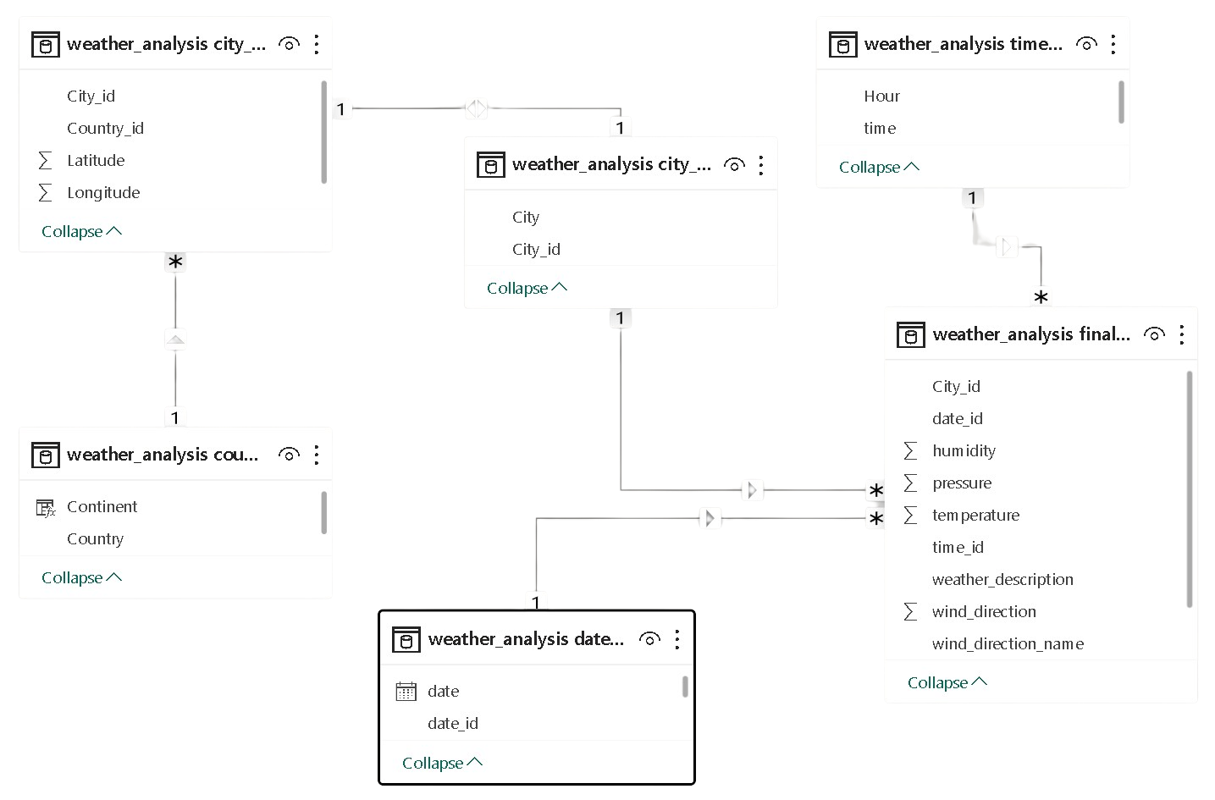
ER Diagram

Slide 6

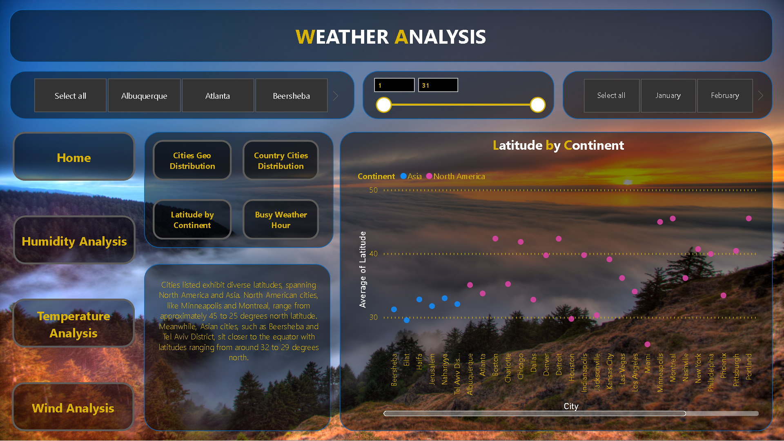
Power BI
Dashboard

Slide 7
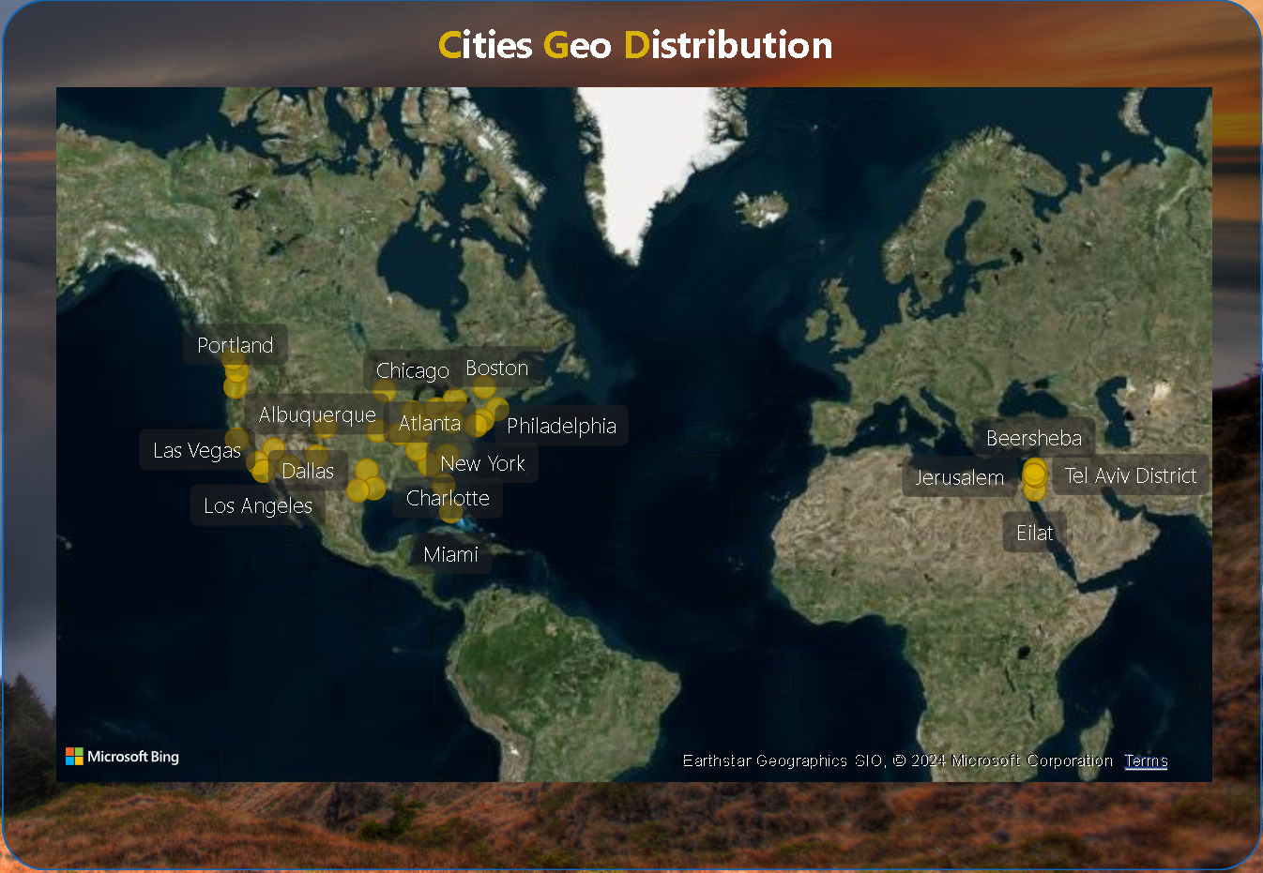
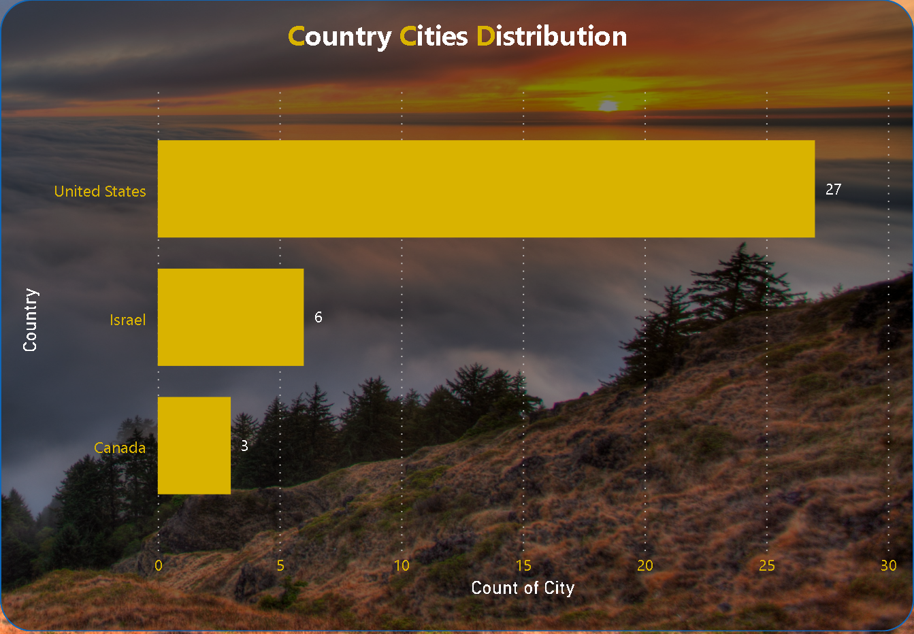
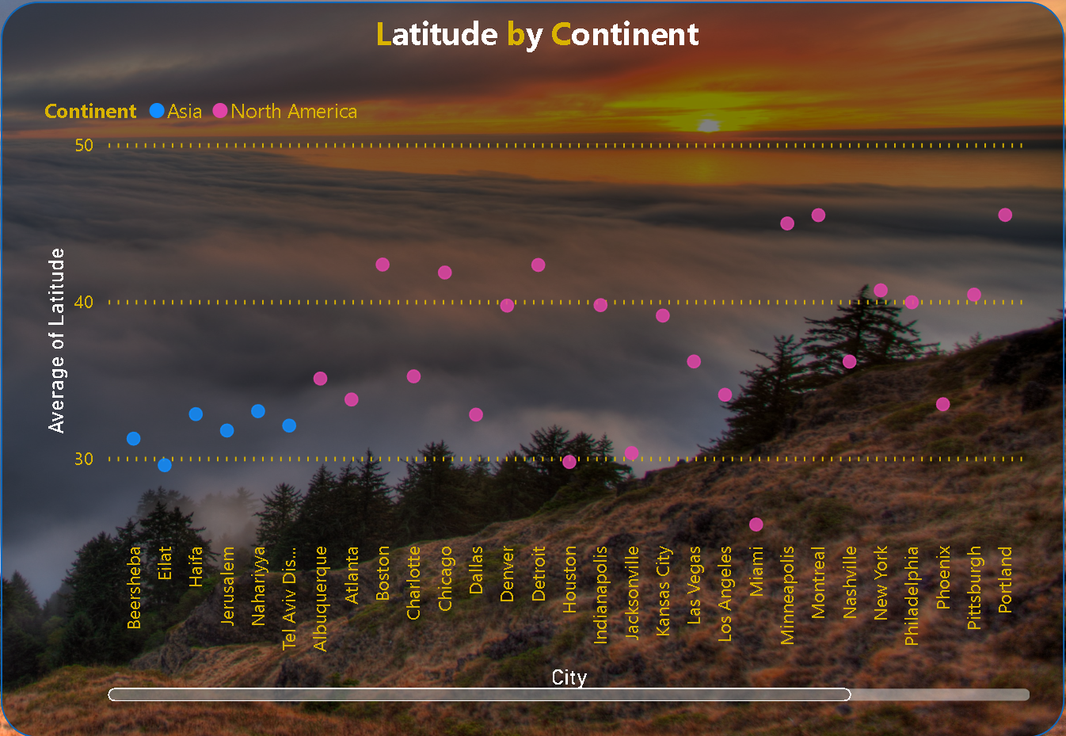
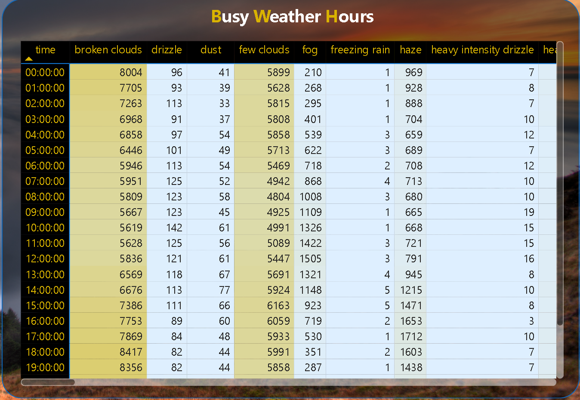




Power BI
Dashboard
Power BI
Home Page
Qualitative weather insights.
Understanding weather conditions.
Categorizing weather types.
Seamless access to different sections.
Streamlined user experience.
Enhances dashboard usability.
Refine data based on preferences.
Customized analysis options.
Tailored insights for users.
Explore weather data by city.
Compare multiple locations.
Understand regional weather patterns.
Home
Navigation
Filter
City

Slide 8

Power BI
Home Page
Qualitative weather insights.
Understanding weather conditions.
Categorizing weather types.
Seamless access to different sections.
Streamlined user experience.
Enhances dashboard usability.
Refine data based on preferences.
Customized analysis options.
Tailored insights for users.
Explore weather data by city.
Compare multiple locations.
Understand regional weather patterns.
Home
Navigation
Filter
City

Slide 9
Can you create a geographical map in Power BI showing the distribution of cities in the dataset based on their latitude and longitude?
Each row represents a city, displaying its average longitude, latitude, and count. For instance, Jerusalem stands out with the highest longitude average at 35.22, while Vancouver has the lowest at -123.12. This setup facilitates efficient visualization and analysis.
Qualitative weather insights.
Understanding weather conditions.
Categorizing weather types.
Seamless access to different sections.
Streamlined user experience.
Enhances dashboard usability.
Refine data based on preferences.
Customized analysis options.
Tailored insights for users.
Explore weather data by city.
Compare multiple locations.
Understand regional weather patterns.
Home
Navigation
Filter
City

Slide 10
In Power BI, can you create a bar chart representing the top 10 countries with the highest number of cities in the dataset?
In the analysis of city counts across countries, the United States emerged with the highest count at 27, showcasing a significant lead over Canada, which had the lowest count at 3, marking an 800.00% difference. Following the United States, Israel stood at 6 cities. Remarkably, the United States accounted for 75.00% of the total city count, with Canada and Israel contributing 8.33% and 16.67% respectively. This data underscores the prominence of the United States in terms of city distribution among the countries analyzed.

Slide 11
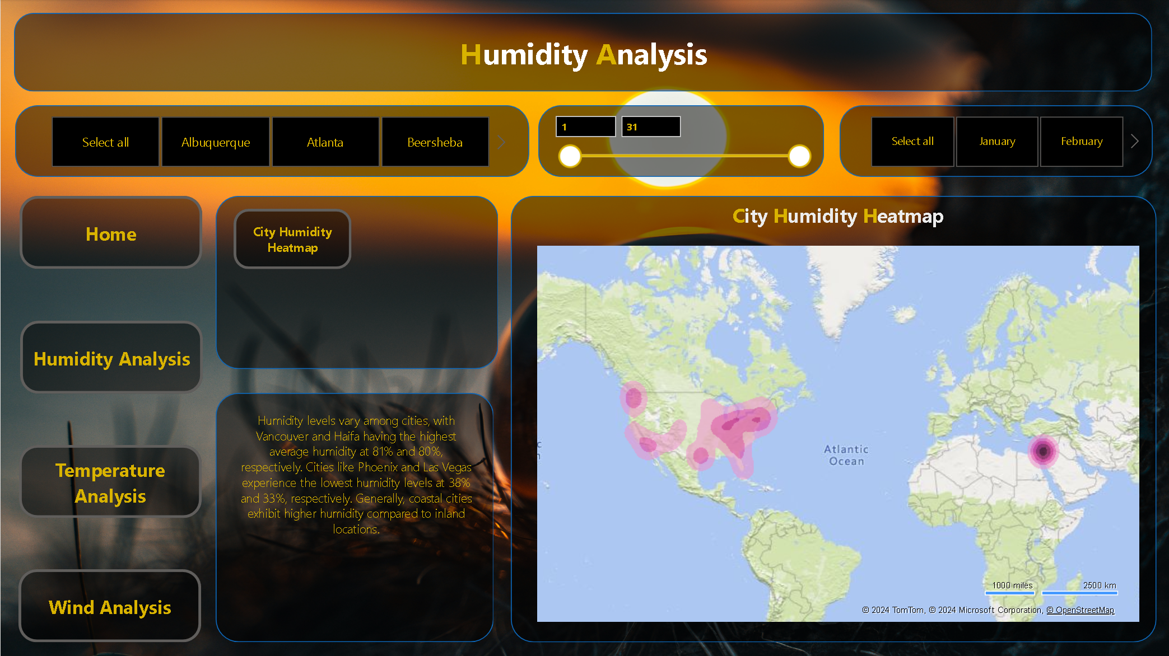
How does the distribution of cities in terms of latitude vary across different continents? Create a scatter plot in Power BI to illustrate this.
Cities listed exhibit diverse latitudes, spanning North America and Asia. North American cities, like Minneapolis and Montreal, range from approximately 45 to 25 degrees north latitude. Meanwhile, Asian cities, such as Beersheba and Tel Aviv District, sit closer to the equator with latitudes ranging from around 32 to 29 degrees north.

Slide 12
Can you create a heatmap in Power BI to visualize the busiest hours for specific weather conditions (e.g., "clear sky," "rainy")?
The data represents weather conditions recorded at different hours. The most frequent condition is ‘sky is clear’ with 659,181 occurrences. The least common are ‘freezing rain’, ‘proximity sand/dust whirls’, ‘rain and snow’, ‘sand’, ‘squalls’, and ‘tornado’ with only one occurrence each. The total count is 1,629,108.

Slide 13
Can you create a heatmap in Power BI to visualize the busiest hours for specific weather conditions (e.g., "clear sky," "rainy")?
The data represents weather conditions recorded at different hours. The most frequent condition is ‘sky is clear’ with 659,181 occurrences. The least common are ‘freezing rain’, ‘proximity sand/dust whirls’, ‘rain and snow’, ‘sand’, ‘squalls’, and ‘tornado’ with only one occurrence each. The total count is 1,629,108.

Slide 14

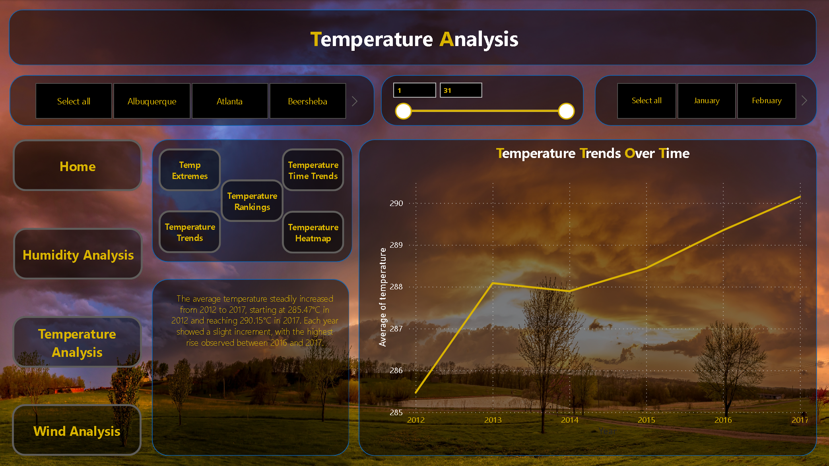
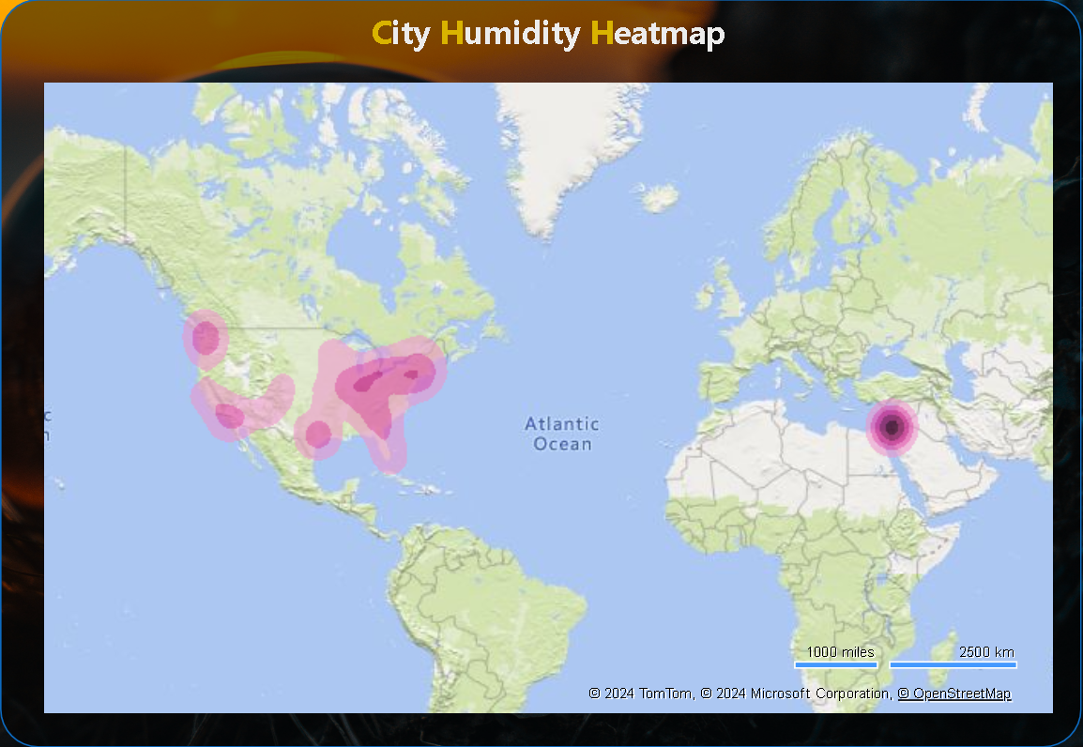

Power BI
Humidity Page
Quantitative moisture levels.
Assessing atmospheric moisture.
Correlating humidity variations.
Seamless access to different sections.
Streamlined user experience.
Enhances dashboard usability.
Refine data based on preferences.
Customized analysis options.
Tailored insights for users.
Explore weather data by city.
Compare multiple locations.
Understand regional weather patterns.
Humidity
Navigation
Filter
City

Slide 15
Power BI
How does humidity vary across different cities? Generate a heatmap in Power BI to visualize this variation.
Humidity Page
Humidity levels vary among cities, with Vancouver and Haifa having the highest average humidity at 81% and 80%, respectively. Cities like Phoenix and Las Vegas experience the lowest humidity levels at 38% and 33%, respectively. Generally, coastal cities exhibit higher humidity compared to inland locations.
Quantitative moisture levels.
Assessing atmospheric moisture.
Correlating humidity variations.
Seamless access to different sections.
Streamlined user experience.
Enhances dashboard usability.
Refine data based on preferences.
Customized analysis options.
Tailored insights for users.
Explore weather data by city.
Compare multiple locations.
Understand regional weather patterns.
Humidity
Navigation
Filter
City

Slide 17

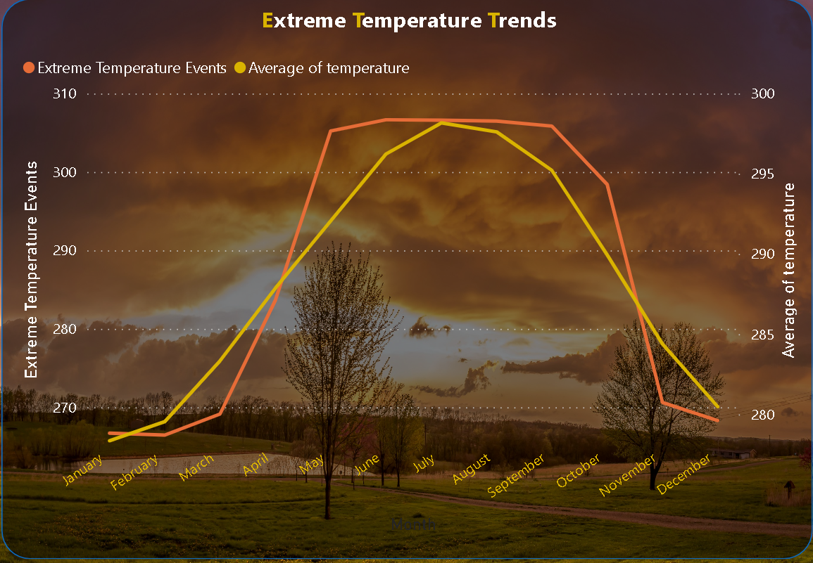
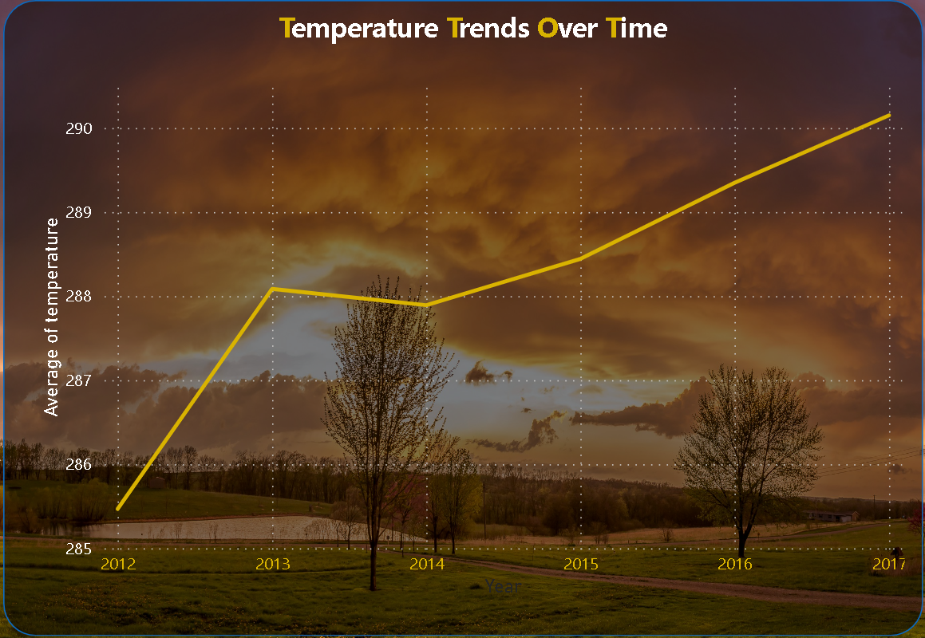
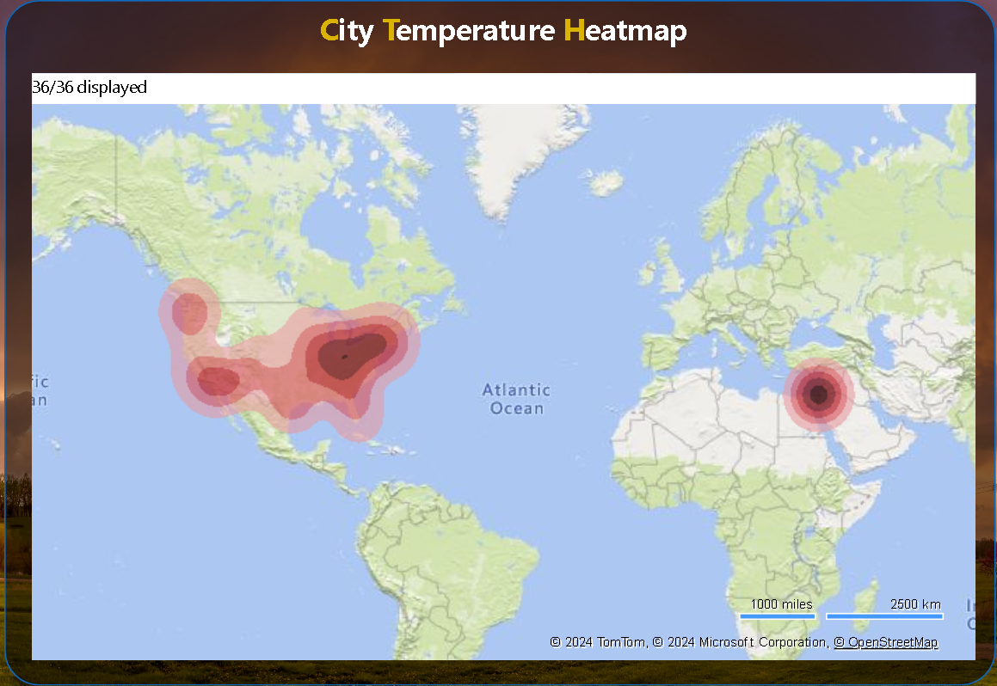
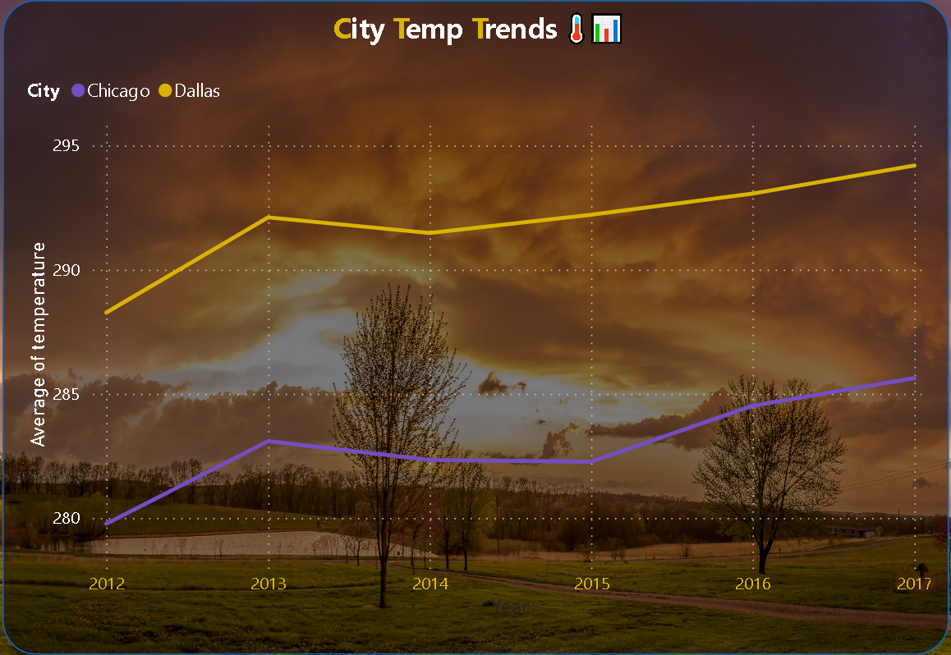
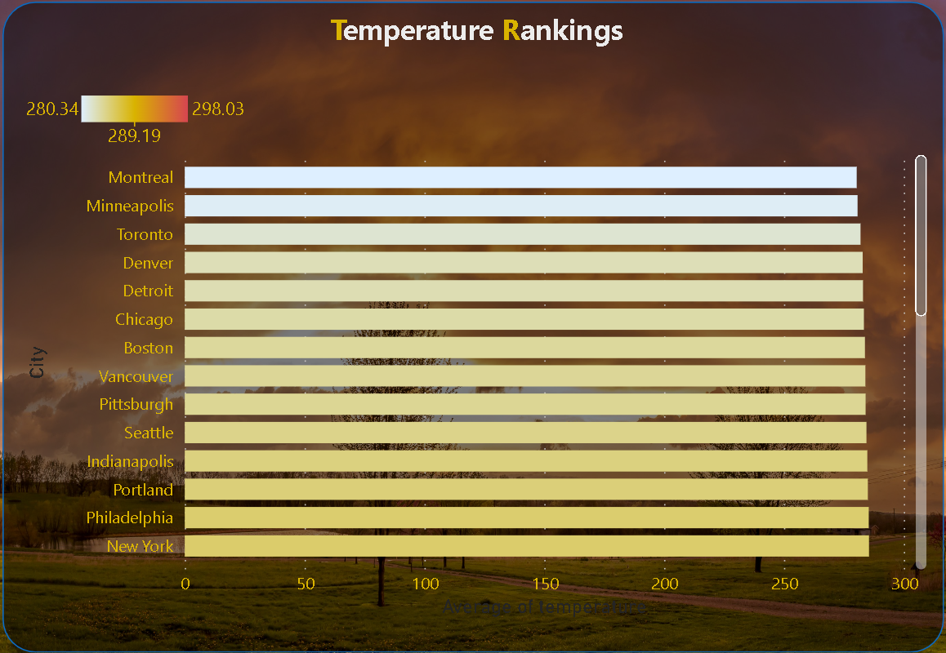

Power BI
Temperature Page
Quantitative heat levels.
Assessing atmospheric temperature.
Correlating temperature variations.
Seamless access to different sections.
Streamlined user experience.
Enhances dashboard usability.
Refine data based on preferences.
Customized analysis options.
Tailored insights for users.
Explore weather data by city.
Compare multiple locations.
Understand regional weather patterns.
Temperature
Navigation
Filter
City

Slide 18
Create a line chart in Power BI to display the temperature trends over time for a selected city. Highlight extreme temperature events.
Extreme temperature events peaked in June and July, reaching 305.67°C and 305.85°C respectively. Lowest temperatures were in January and November at 268.73°C and 270.31°C. Overall, temperatures rose from January to July before declining slightly towards December.
Quantitative heat levels.
Assessing atmospheric temperature.
Correlating temperature variations.
Seamless access to different sections.
Streamlined user experience.
Enhances dashboard usability.
Refine data based on preferences.
Customized analysis options.
Tailored insights for users.
Explore weather data by city.
Compare multiple locations.
Understand regional weather patterns.
Temperature
Navigation
Filter
City

Slide 19
Create a time-series line chart in Power BI to show the overall temperature trends over the entire dataset.
The average temperature steadily increased from 2012 to 2017, starting at 285.47°C in 2012 and reaching 290.15°C in 2017. Each year showed a slight increment, with the highest rise observed between 2016 and 2017.

Slide 20
Create a Power BI chart comparing the temperature variations between two selected cities over a specific timeframe.
From 2012 to 2017, Atlanta experienced a gradual temperature rise, reaching 291.67°C in 2017. Boston also saw an upward trend, with temperatures climbing from 279.93°C in 2012 to 285.27°C in 2017. Atlanta consistently maintained higher temperatures compared to Boston throughout the period.

Slide 21
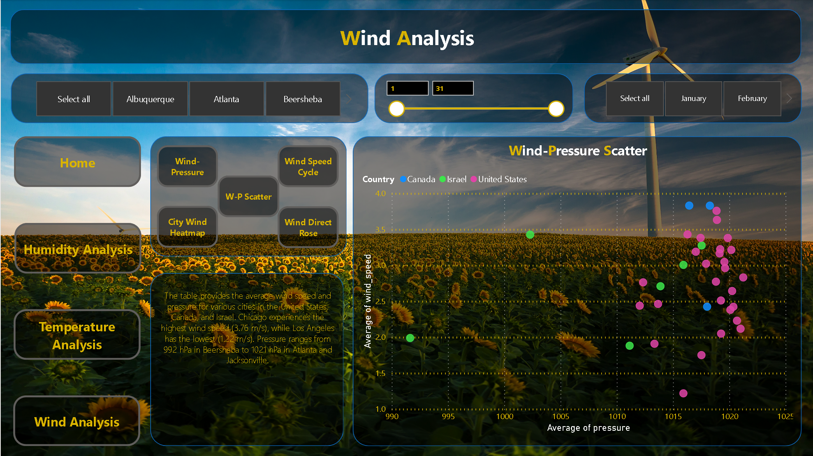
Can you build a heatmap in Power BI to show the temperature ranges for cities across different countries?
Cities exhibit diverse average temperatures: Miami, United States, records the highest at 298.03°C, while Montreal, Canada, experiences the lowest at 280.34°C. Tel Aviv District, Israel, sees a moderate 294.43°C. United States cities vary from 280.70°C in Minneapolis to 298.03°C in Miami.

Slide 22
Create a bar chart in Power BI to highlight cities with the highest and lowest average temperatures in the dataset.
Cities exhibit varied average temperatures: Miami, USA, records the highest at 298.03°C, while Montreal, Canada, experiences the lowest at 280.34°C. Tel Aviv District, Israel, sees 294.43°C, while major US cities range from 280.70°C in Minneapolis to 298.03°C in Miami.

Slide 24

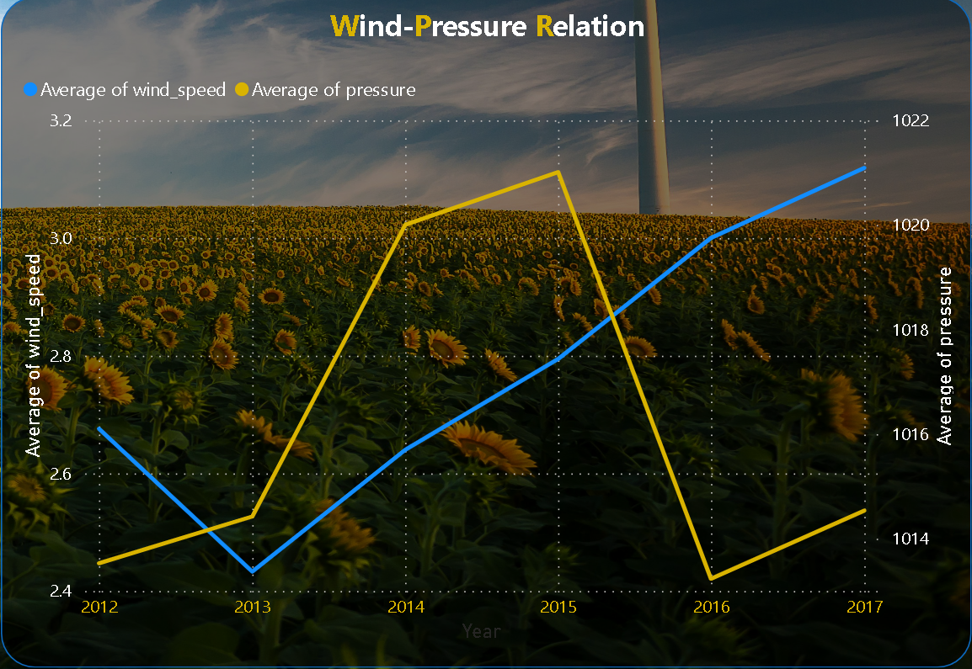

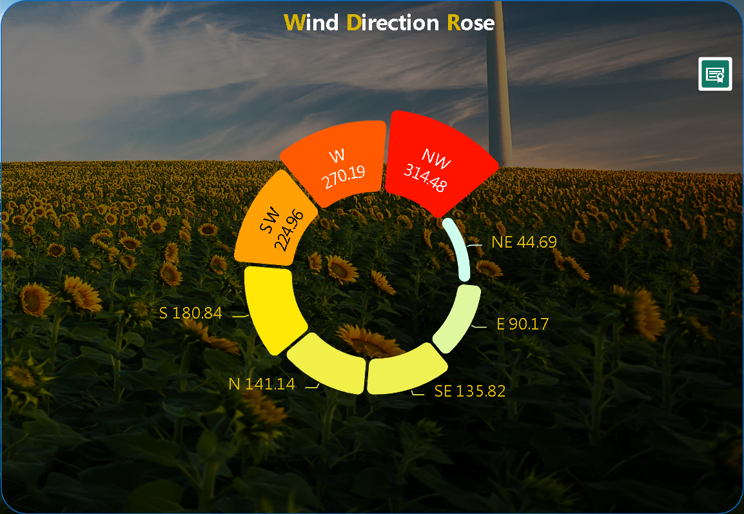
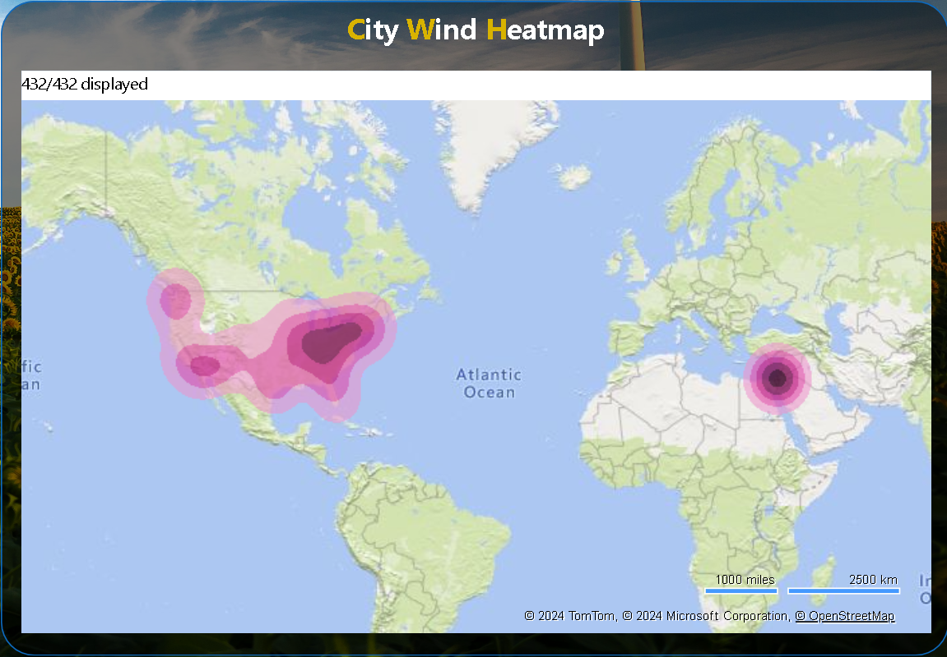
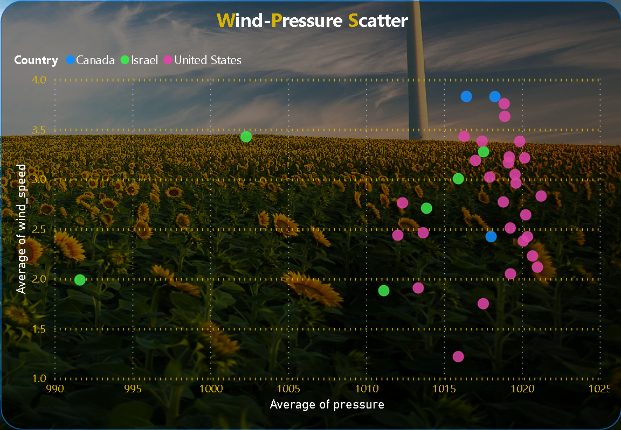

Power BI
Wind Page
Understanding wind intensity.
Assessing atmospheric movement.
Correlating wind speed variations.
Seamless access to different sections.
Streamlined user experience.
Enhances dashboard usability.
Refine data based on preferences.
Customized analysis options.
Tailored insights for users.
Explore weather data by city.
Compare multiple locations.
Understand regional weather patterns.
Wind
Navigation
Filter
City

Slide 25
Can you create a time-series chart in Power BI showing the relationship between wind speed and air pressure for a specific city?
Over the period from 2012 to 2017, wind speed fluctuated, with a range from 1.86 to 3.65. Pressure remained relatively stable around 1010 to 1031. Variations were observed across months and years, reflecting seasonal and possibly climatic influences on wind and pressure patterns.
Understanding wind intensity.
Assessing atmospheric movement.
Correlating wind speed variations.
Seamless access to different sections.
Streamlined user experience.
Enhances dashboard usability.
Refine data based on preferences.
Customized analysis options.
Tailored insights for users.
Explore weather data by city.
Compare multiple locations.
Understand regional weather patterns.
Wind
Navigation
Filter
City

Slide 26
How does the wind speed change over the course of a day? Create a radial chart in Power BI to represent this.
The average wind speed shows variation across hours, peaking at 3.20 during the 20th hour and dropping to 2.47 during the 7th hour. Generally, wind speeds are higher during late afternoon and early evening hours, while they decrease during early morning and late night hours.

Slide 27
Create a wind rose chart in Power BI to visualize the prevailing wind directions for a selected city.
Wind directions are represented across compass points, with the average direction ranging from 44.69° (NE) to 314.48° (NW). The prevailing wind direction is southerly (S), while the least common is northeasterly (NE). Other directions fall in between, forming a circular pattern of wind flow.

Slide 28

Can you generate a Power BI heatmap illustrating the average wind speeds across cities for different months of the year?
The average wind speeds vary across cities and months. Toronto experiences high winds in February (5.23 m/s) and January (4.97 m/s), while Eilat encounters strong winds in July (4.61 m/s). Dallas has significant wind speeds in April (4.51 m/s), showing seasonal fluctuations in wind intensity across different locations and times.

Slide 29
Create a Power BI scatter plot to show the relationship between wind speed and air pressure for a specific city.
The table provides the average wind speed and pressure for various cities in the United States, Canada, and Israel. Chicago experiences the highest wind speed (3.76 m/s), while Los Angeles has the lowest (1.22 m/s). Pressure ranges from 992 hPa in Beersheba to 1021 hPa in Atlanta and Jacksonville.

Slide 30
EDA

